Slide 1

BIKE SHARING ASSIGNMENT
By:PRATIBHA VERMA

Slide 2

Problem Statement
A bike-sharing system is a service in which bikes are made available for shared use to individuals on a short term basis for a price or free. Many bike share systems allow people to borrow a bike from a "dock" which is usually computer-controlled wherein the user enters the payment information, and the system unlocks it. This bike can then be returned to another dock belonging to the same system.
A US bike-sharing provider BoomBikes has recently suffered considerable dips in their revenues due to the ongoing Corona pandemic. The company is finding it very difficult to sustain in the current market scenario. So, it has decided to come up with a mindful business plan to be able to accelerate its revenue as soon as the ongoing lockdown comes to an end, and the economy restores to a healthy state.
In such an attempt, BoomBikes aspires to understand the demand for shared bikes among the people after this ongoing quarantine situation ends across the nation due to Covid-19. They have planned this to prepare themselves to cater to the people's needs once the situation gets better all around and stand out from other service providers and make huge profits.
They have contracted a consulting company to understand the factors on which the demand for these shared bikes depends. Specifically, they want to understand the factors affecting the demand for these shared bikes in the American market. The company wants to know:
Which variables are significant in predicting the demand for shared bikes.
How well those variables describe the bike demands
Based on various meteorological surveys and people's styles, the service provider firm has gathered a large dataset on daily bike demands across the American market based on some factors.

Slide 3

Business Goal:
You are required to model the demand for shared bikes with the available independent variables. It will be used by the management to understand how exactly the demands vary with different features. They can accordingly manipulate the business strategy to meet the demand levels and meet the customer's expectations. Further, the model will be a good way for management to understand the demand dynamics of a new market.

Slide 4

CATEGORICAL UNIVARIATE ANALYSIS FOR TARGET

Slide 5
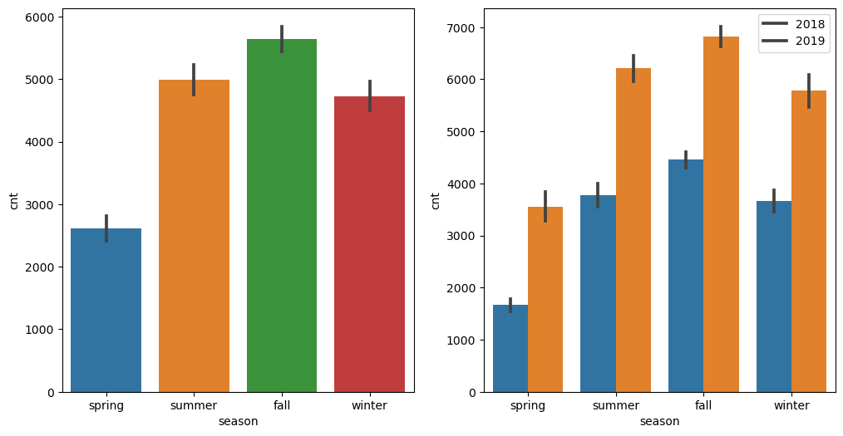
BARPLOT FOR "SEASON" AGAINST BIKE SELLING
Fall season seems to have attracted more booking. And, in each season the booking count has increased drastically from 2018 to 2019.

Slide 6
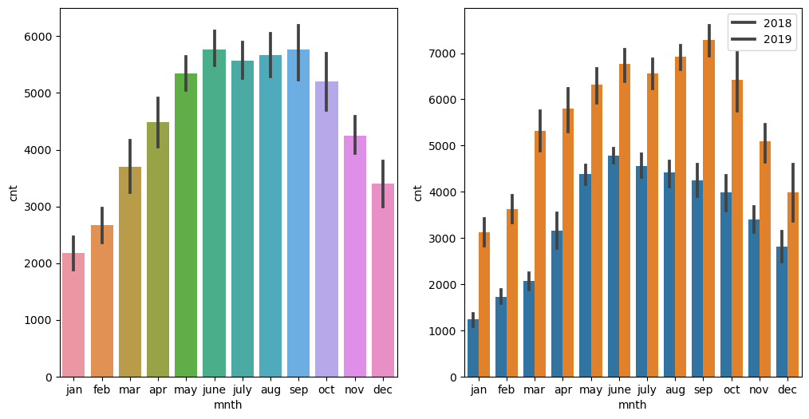
BARPLOT FOR "MONTH" AGAINST BIKE SELLING
Most of the bookings has been done during the month of may, june, july, aug, sep and oct.Trend increased starting of the year till mid of the year and then it started decreasing as we approached the end of year. Number of booking for each month seems to have increased from 2018 to 2019.

Slide 7
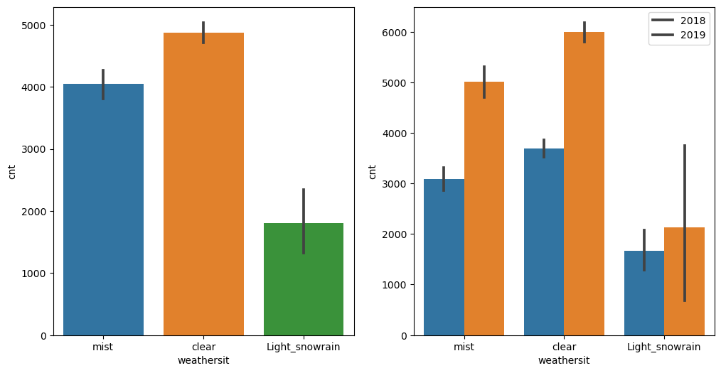
BARPLOT FOR "WEATHERSIT" AGAINST BIKE SELLING
Clear weather attracted more booking which seems obvious. And in comparison to previous year, i.e 2018, booking increased for each weather situation in 2019.

Slide 8
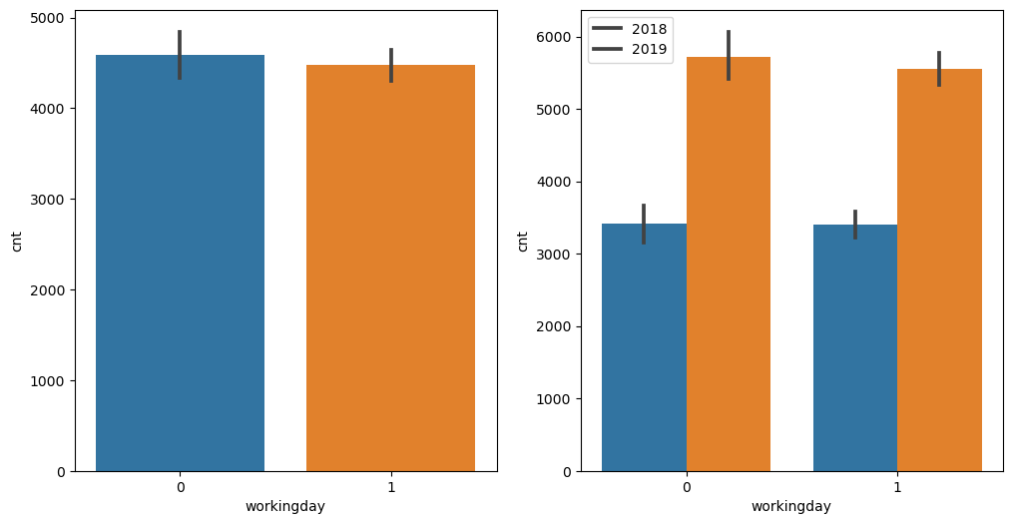
BARPLOT FOR "WORKINGDAY" AGAINST BIKE SELLING
Booking seemed to be almost equal either on working day or non-working day. But, the count increased from 2018 to 2019.

Slide 9
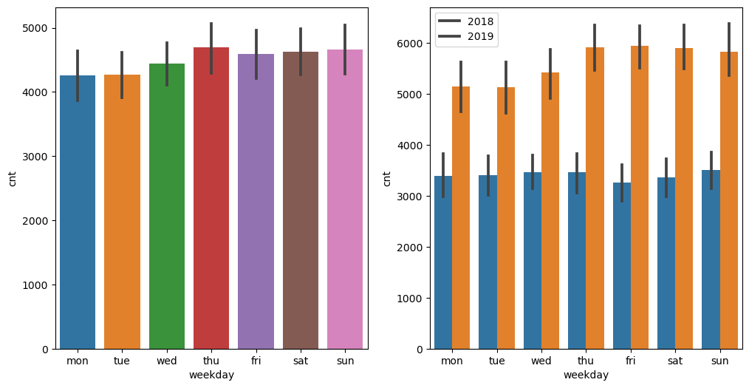
BARPLOT FOR "WEEKDAY" AGAINST BIKE SELLING
Thu, Fir, Sat and Sun have more number of bookings as compared to the start of the week

Slide 10
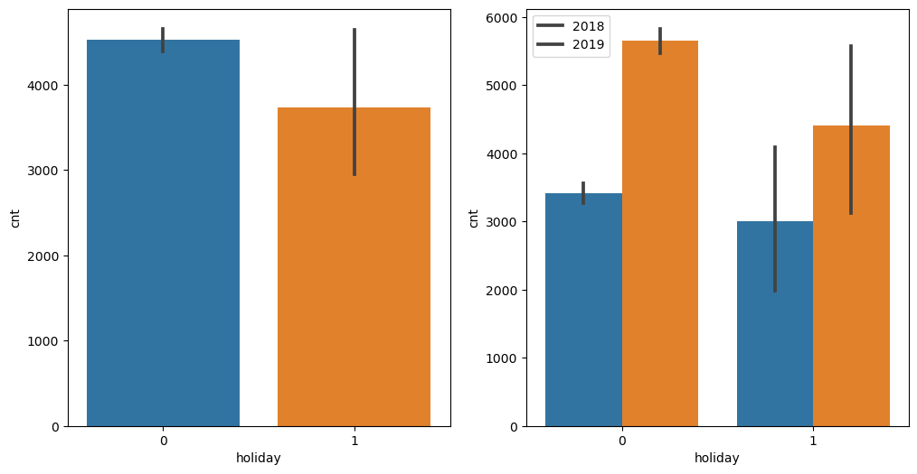
BARPLOT FOR "HOLIDAY" AGAINST BIKE SELLING
When its holiday, booking seems to be less in number which seems reasonable as on holidays, people may want to spend time at home and enjoy with family.

Slide 11
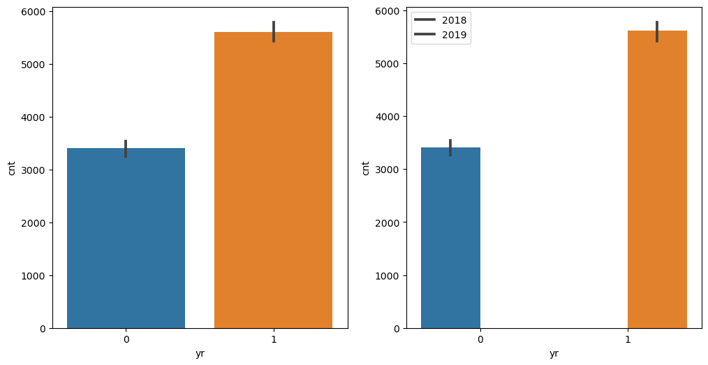
BARPLOT FOR "YEAR" AGAINST BIKE SELLING
2019 attracted more number of booking from the previous year, which shows good progress in terms of business.

Slide 12
CONTINUOUS UNIVARIATE ANALYSIS FOR TARGET

Slide 13
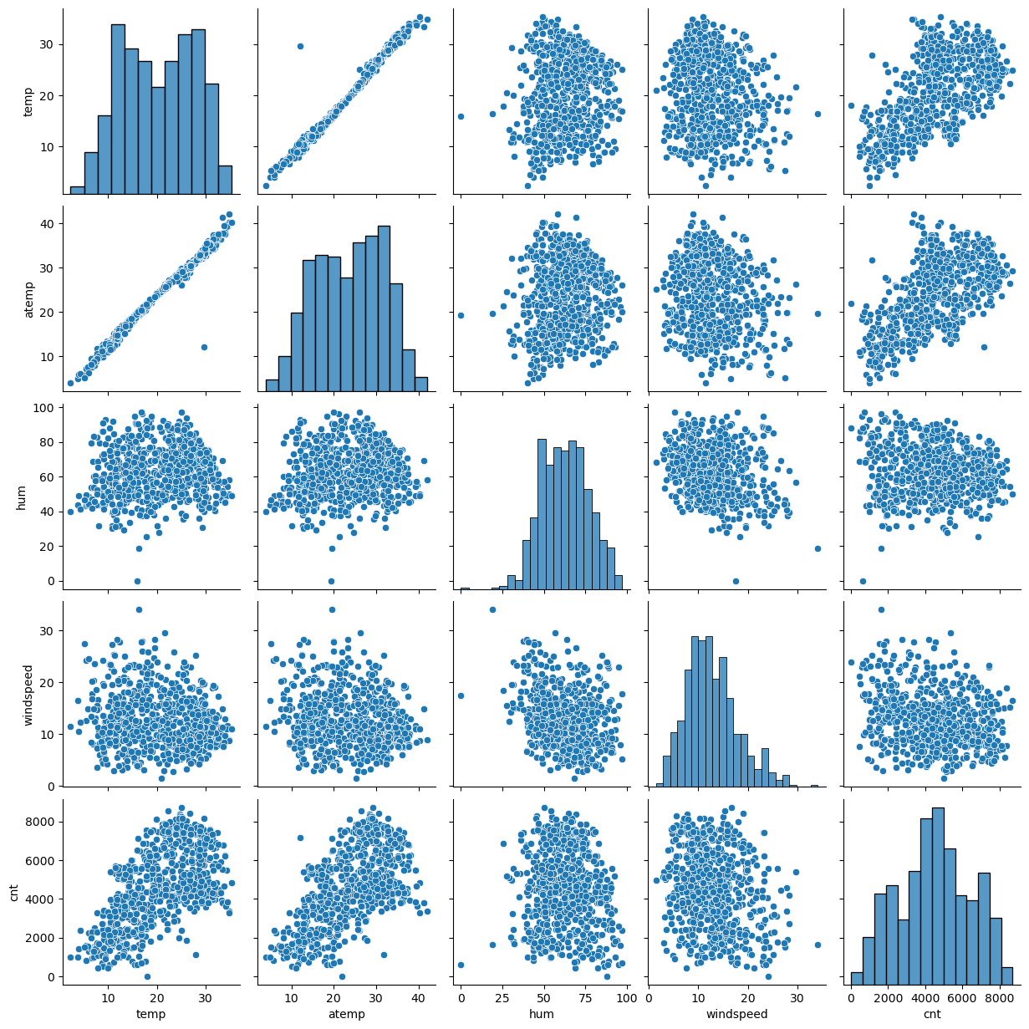
visualizing the numerical columns:['temp','atemp','hum','windspeed','cnt']

Slide 14
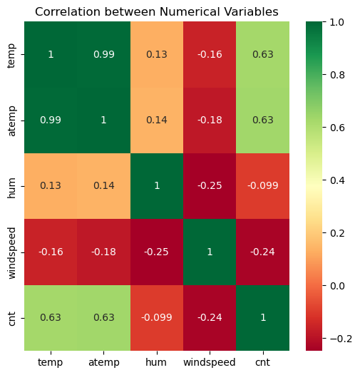
correlation between the numerical variables
There is linear relationship between temp and atemp. Both of the parameters cannot be used in the model due to multicolinearity. We will decide which parameters to keep based on VIF and p-value w.r.t other variables

Slide 15
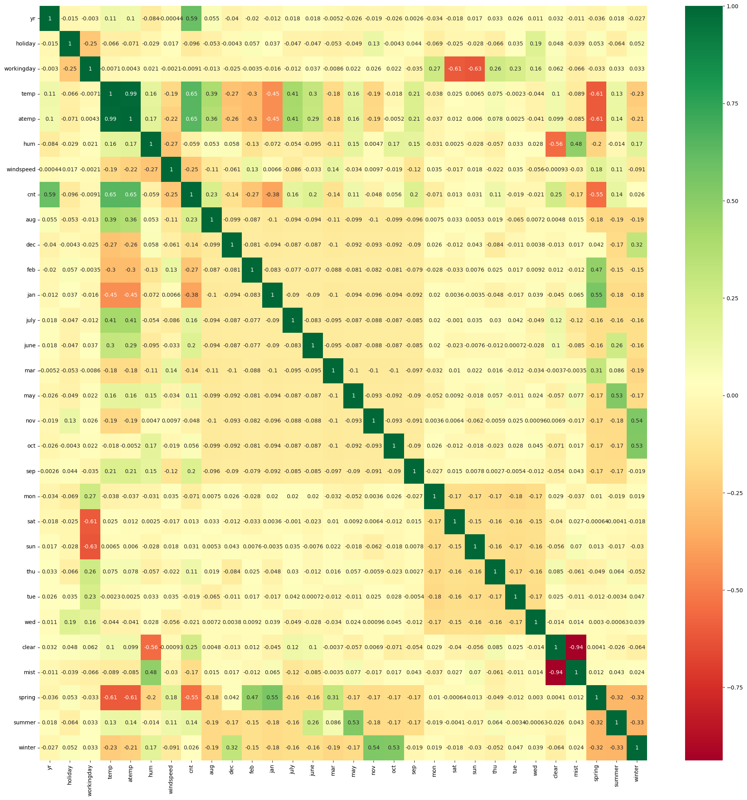
correlation coefficients to see which variables are highly correlated
cnt seems to have correlation with year variable and temp. Similarly, Misty and humidity show correlation. Spring season with Jan and Feb month, Summer season with may month and Winter season with oct and nov month show good correlation.¶

Slide 16
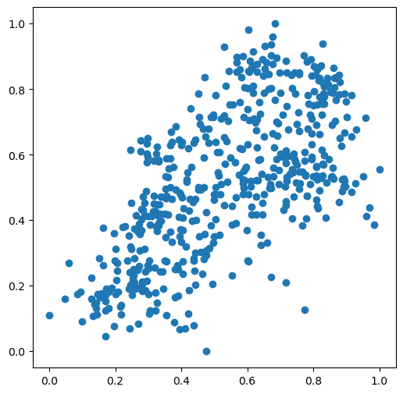
Visualizing one of the correlation to see the trends via Scatter plot.
Visualization confirms the positive correlation between temp and cnt.

Slide 17
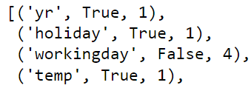
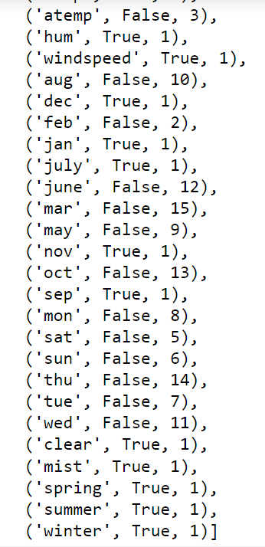
#USING RFE APPROACH FOR FEATURE SELECTION

Slide 18
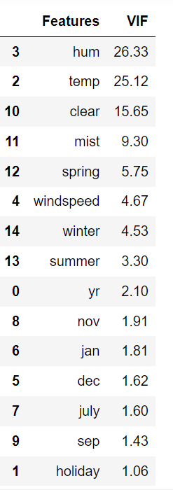
calculate VIF of variables

Slide 19
Building a linear model

Slide 20
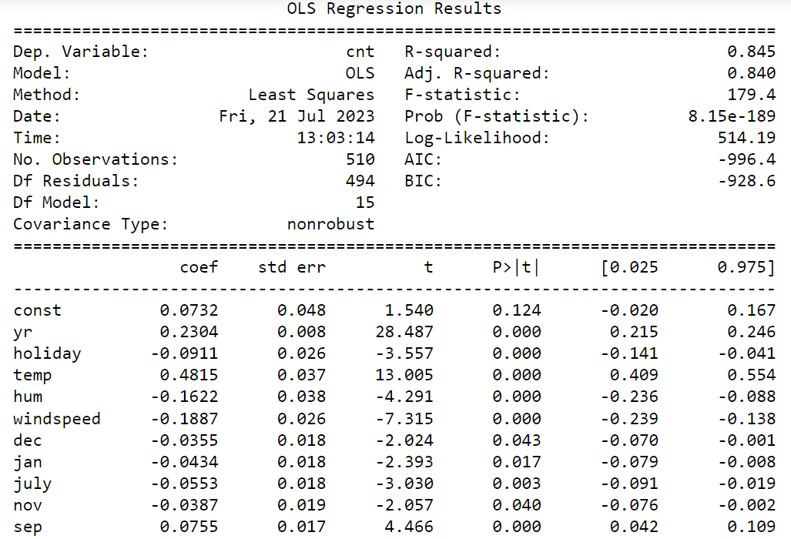
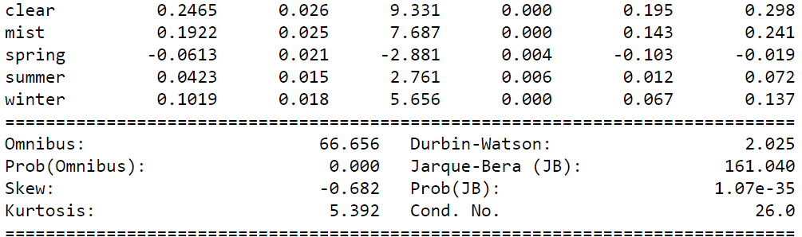
##1st linear model and its vif

Slide 21
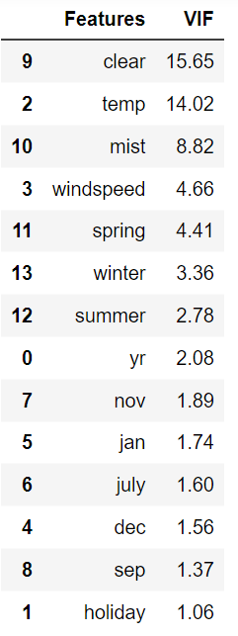
VIF values seems to be good now. But we will see if we can reduce further ?

Slide 22
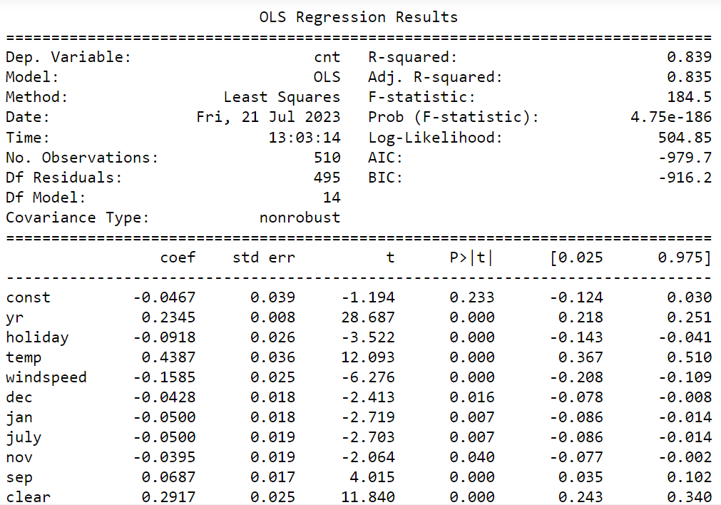
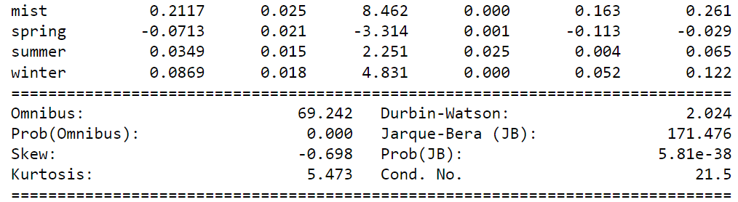
##2nd linear model and its vif

Slide 23
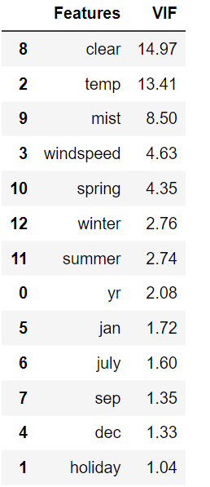
VIF doesnt seems to be affected much after dropping few of the variables. Lets proceed more to observe better model.

Slide 24
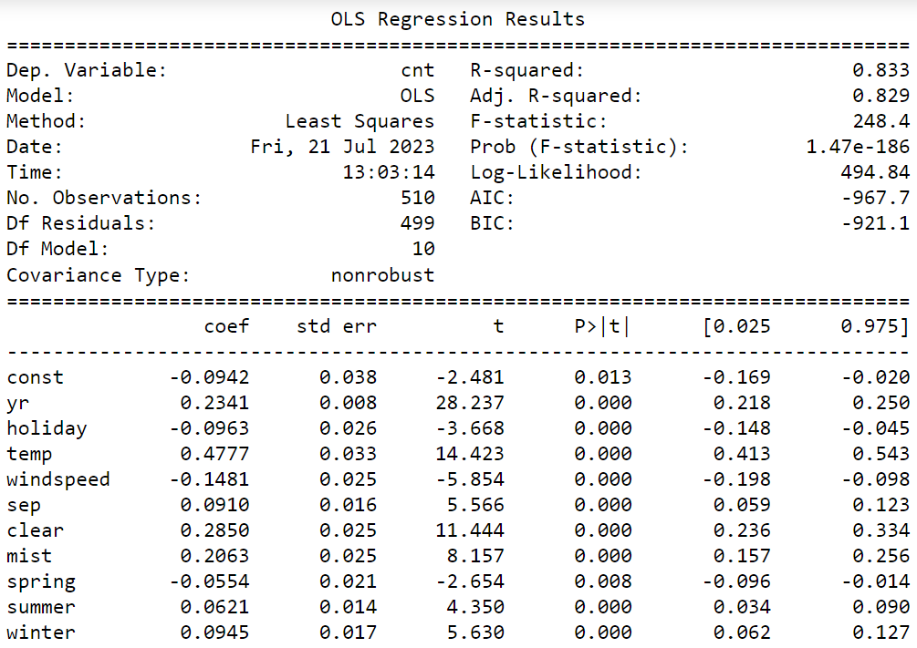
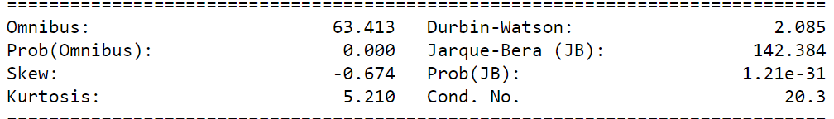
##3rd linear model and its vif

Slide 25
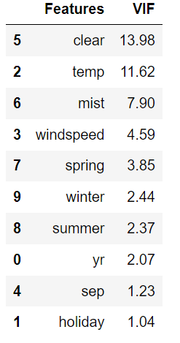
VIF value now seems to be good as it came below 5.

Slide 26
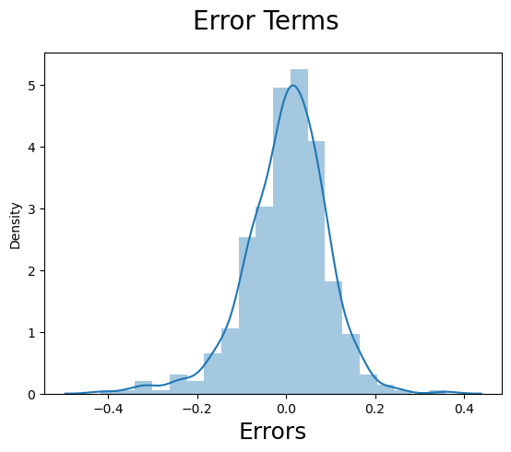
histogram of the error terms
Error terms are following normal distribution

Slide 27
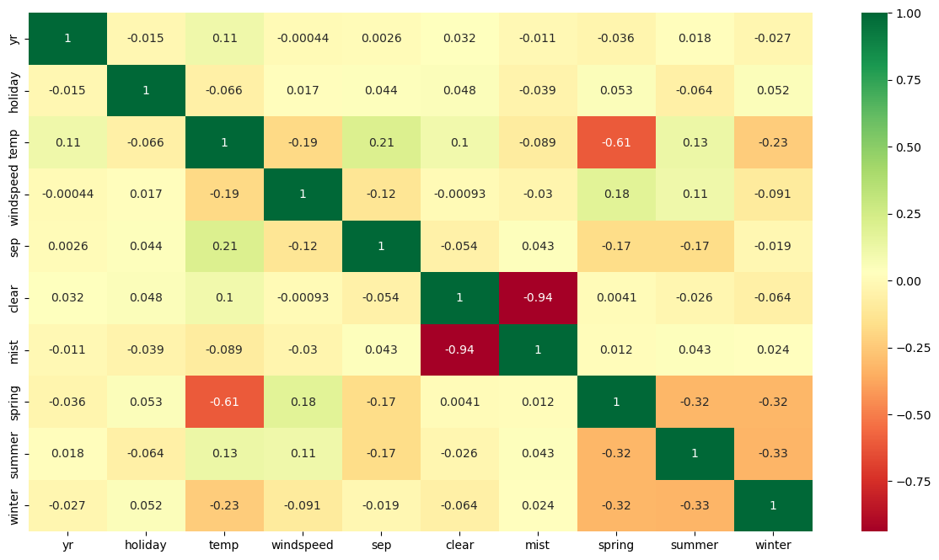
Multi Colinearity
There is no multicolinearity as seen from the heatmap

Slide 28
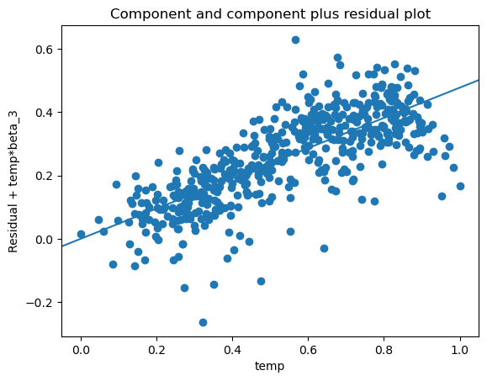
Linearity
# Linear relationship validation using CCPR plot
# Component and component plus residual plot

Slide 29
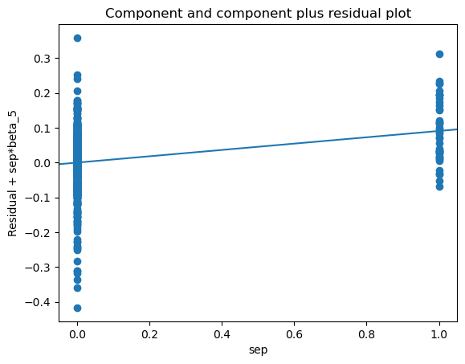

Slide 30
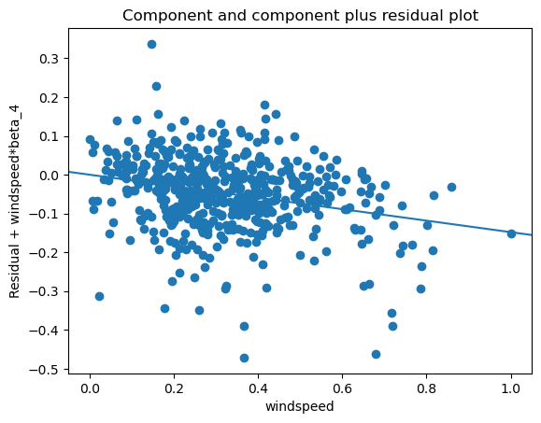

Slide 31
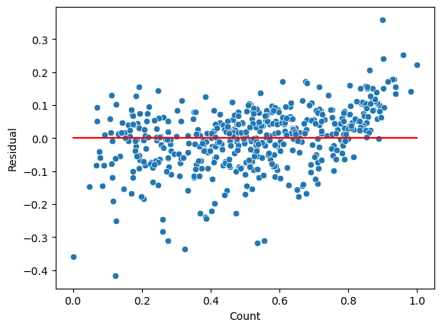
Homoscedasticity
No visible pattern observed from above plot for residuals.

Slide 32
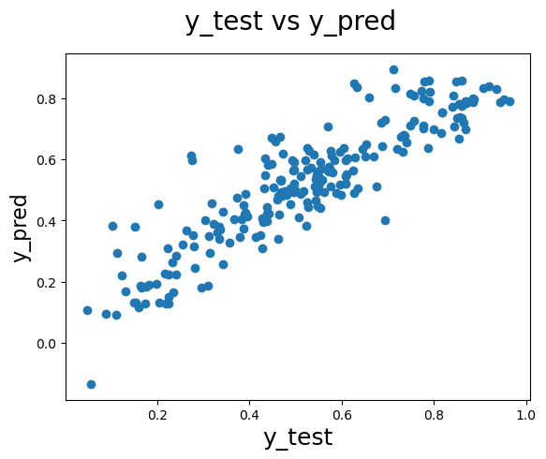
Model Evaluation
Let's now plot the graph for actual versus predicted values.

Slide 33
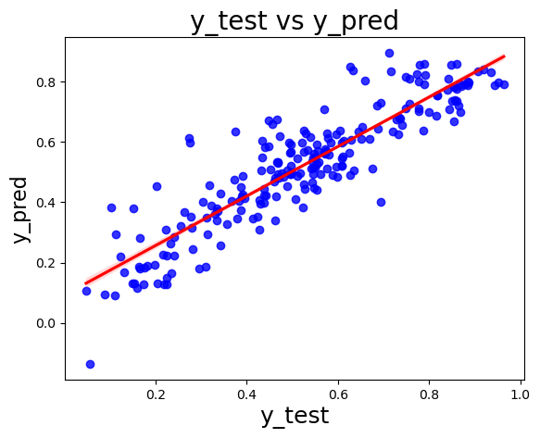
# Visualizing the fit on the test data
# plotting a Regression plot

Slide 34
Comparison between Training and Testing dataset:
Train dataset R^2 : 0.833
Test dataset R^2 : 0.8038
Train dataset Adjusted R^2 : 0.829
Test dataset Adjusted R^2 : 0.7944
Demand of bikes depend on year, holiday, temp, windspeed, sep, Light_snowrain, Misty, spring, summer and winter.

